Slide 1


Welcome​
Ms Toone – Pastoral Year Co-Ordinator​
Mr Cunniffe – Director of Learning ​
Ms Bolayon – Assistant Head Teacher with oversight for KS4​
Notes:
“I just want to spend a couple of minutes on attendance because this is going to be a really important focus for us this year.
We are part of the DfE RISE Intensive Support Programme, and our attendance strategy for this year has been reviewed and approved by the DfE.
For you as Form Tutors, the really important thing to remember is that every register matters. The information you put into Bromcom is pulled centrally and forms part of the attendance data that we submit to the DfE.
So please make sure you are taking your registers promptly, accurately, and updating them if information changes. If you're unsure about a code, don't guess — check with the Attendance Team.

Slide 2
Year 11 Welcome Evening
Key Dates for Year 11​
Expectations – uniform/attendance and punctuality​
RD/Mother Emily Room/ARC ​
Rewards
How we support your child
How can you support your child?​
Questions​
Notes:
“I just want to spend a couple of minutes on attendance because this is going to be a really important focus for us this year.
We are part of the DfE RISE Intensive Support Programme, and our attendance strategy for this year has been reviewed and approved by the DfE.
For you as Form Tutors, the really important thing to remember is that every register matters. The information you put into Bromcom is pulled centrally and forms part of the attendance data that we submit to the DfE.
So please make sure you are taking your registers promptly, accurately, and updating them if information changes. If you're unsure about a code, don't guess — check with the Attendance Team.

Slide 3
Meet the team
Tutor Group | Tutor | Email
A11 | Ms N Boston | nboston@stahigh.org
B11 | Ms. S Walcott | swalcott@stahigh.org
C11 | Ms. Y Lazaar | ylazaar@stahigh.org
D11 | Mr. S Onabanjo | sonabanjo@stahigh.org
E11 F11 G11 | Mr D Horrocks Mr. A Bapir Mr. Whent | dhorrocks@stahigh.org abapir@stahigh.org awhent@stahigh.org
Notes:
“I just want to spend a couple of minutes on attendance because this is going to be a really important focus for us this year.
We are part of the DfE RISE Intensive Support Programme, and our attendance strategy for this year has been reviewed and approved by the DfE.
For you as Form Tutors, the really important thing to remember is that every register matters. The information you put into Bromcom is pulled centrally and forms part of the attendance data that we submit to the DfE.
So please make sure you are taking your registers promptly, accurately, and updating them if information changes. If you're unsure about a code, don't guess — check with the Attendance Team.

Slide 4
Key Dates This Year
14/10/2026 – Parents evening – Mock preparation ​
16/11/2026 – Mock exam period​
30/11/2026 – Post mock upgrade week​
14/1/2026 – Post Mock parents evening​
22/2/2027 – Second mock period​
08/3/2027 – Post mock upgrade week​
10/5/2027 – First Scheduled GCSE exam​
18/6/2026 – Final Scheduled GCSE exam​
Notes:
“I just want to spend a couple of minutes on attendance because this is going to be a really important focus for us this year.
We are part of the DfE RISE Intensive Support Programme, and our attendance strategy for this year has been reviewed and approved by the DfE.
For you as Form Tutors, the really important thing to remember is that every register matters. The information you put into Bromcom is pulled centrally and forms part of the attendance data that we submit to the DfE.
So please make sure you are taking your registers promptly, accurately, and updating them if information changes. If you're unsure about a code, don't guess — check with the Attendance Team.

Slide 5

How can our students be successful
To be successful we need our students to:
Be in school, on time
Be prepared for the school day
Be ready to learn and ready to succeed
Notes:
As a form tutor, you're much more than the person who takes the register. You are often the adult who sees your students most consistently every day. That means you're in the best position to notice changes, celebrate successes, and build relationships.
Our aim is that every student leaves form each day feeling known, safe and ready to learn. If we get those three things right, everything else becomes much easier.
You are the adult who sees students every day.
You are often the first person to notice when something isn't right.
Form time sets the tone for the whole school day.
Your role is pastoral, academic and organisational.

Slide 6
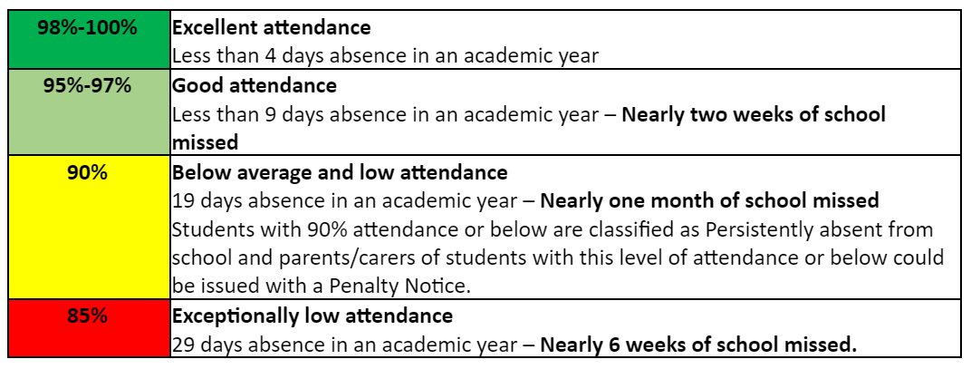
Be in school and on time…
“Among pupils with no missed sessions over KS4, 83.7% achieved grades 9 to 4 in English and maths compared to 35.6% of pupils who were persistently absent.” https://explore-education-statistics.service.gov.uk/find-statistics/the-link-between-absence-and-attainment-at-ks2-and-ks4
Notes:
As a form tutor, you're much more than the person who takes the register. You are often the adult who sees your students most consistently every day. That means you're in the best position to notice changes, celebrate successes, and build relationships.
Our aim is that every student leaves form each day feeling known, safe and ready to learn. If we get those three things right, everything else becomes much easier.
You are the adult who sees students every day.
You are often the first person to notice when something isn't right.
Form time sets the tone for the whole school day.
Your role is pastoral, academic and organisational.

Slide 7
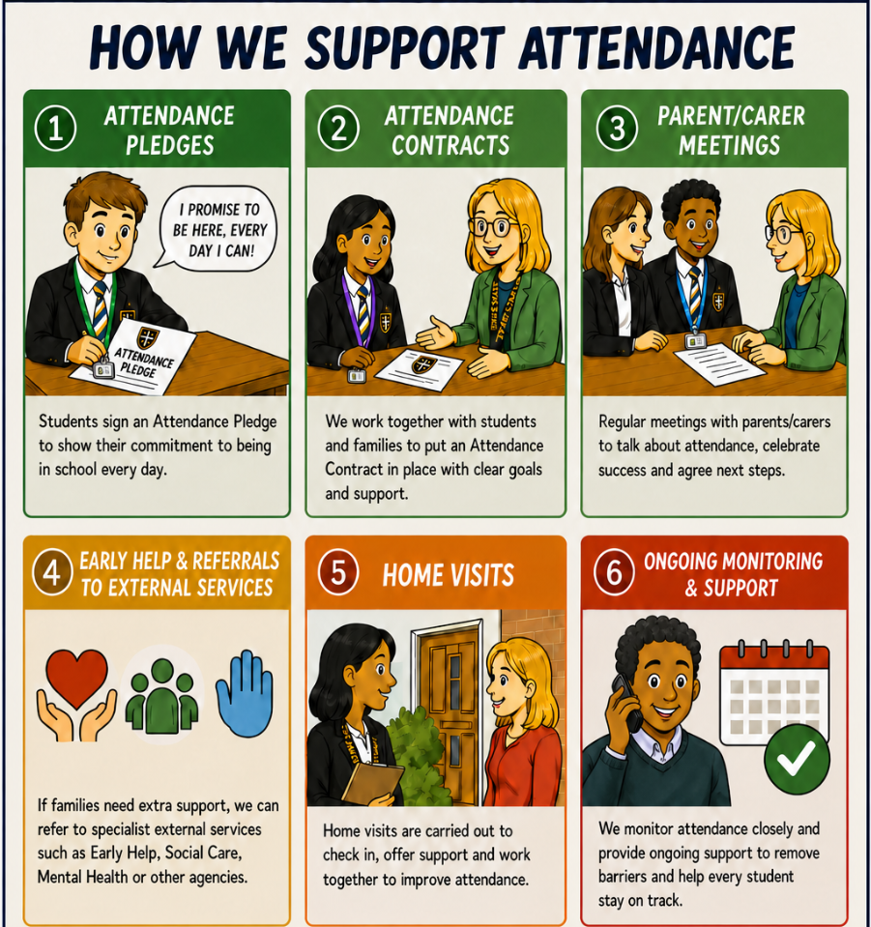
Attendance – How we support students
Notes:
“I just want to spend a couple of minutes on attendance because this is going to be a really important focus for us this year.
We are part of the DfE RISE Intensive Support Programme, and our attendance strategy for this year has been reviewed and approved by the DfE.
For you as Form Tutors, the really important thing to remember is that every register matters. The information you put into Bromcom is pulled centrally and forms part of the attendance data that we submit to the DfE.
So please make sure you are taking your registers promptly, accurately, and updating them if information changes. If you're unsure about a code, don't guess — check with the Attendance Team.

Slide 8
Be in school and on time…
To AM reg:
Students need to be in AM reg at/before 8.45am
Students are late if they arrive at the gate after 8.45am
To lessons:
Students have a 4 minute grace period to get from one lesson to another
If student arrive after this 4 minute period they are marked late
At St Augustine's we believe it is important to maximise learning time and ensure every minute of every lesson is disruption free.
Notes:
“I just want to spend a couple of minutes on attendance because this is going to be a really important focus for us this year.
We are part of the DfE RISE Intensive Support Programme, and our attendance strategy for this year has been reviewed and approved by the DfE.
For you as Form Tutors, the really important thing to remember is that every register matters. The information you put into Bromcom is pulled centrally and forms part of the attendance data that we submit to the DfE.
So please make sure you are taking your registers promptly, accurately, and updating them if information changes. If you're unsure about a code, don't guess — check with the Attendance Team.

Slide 9
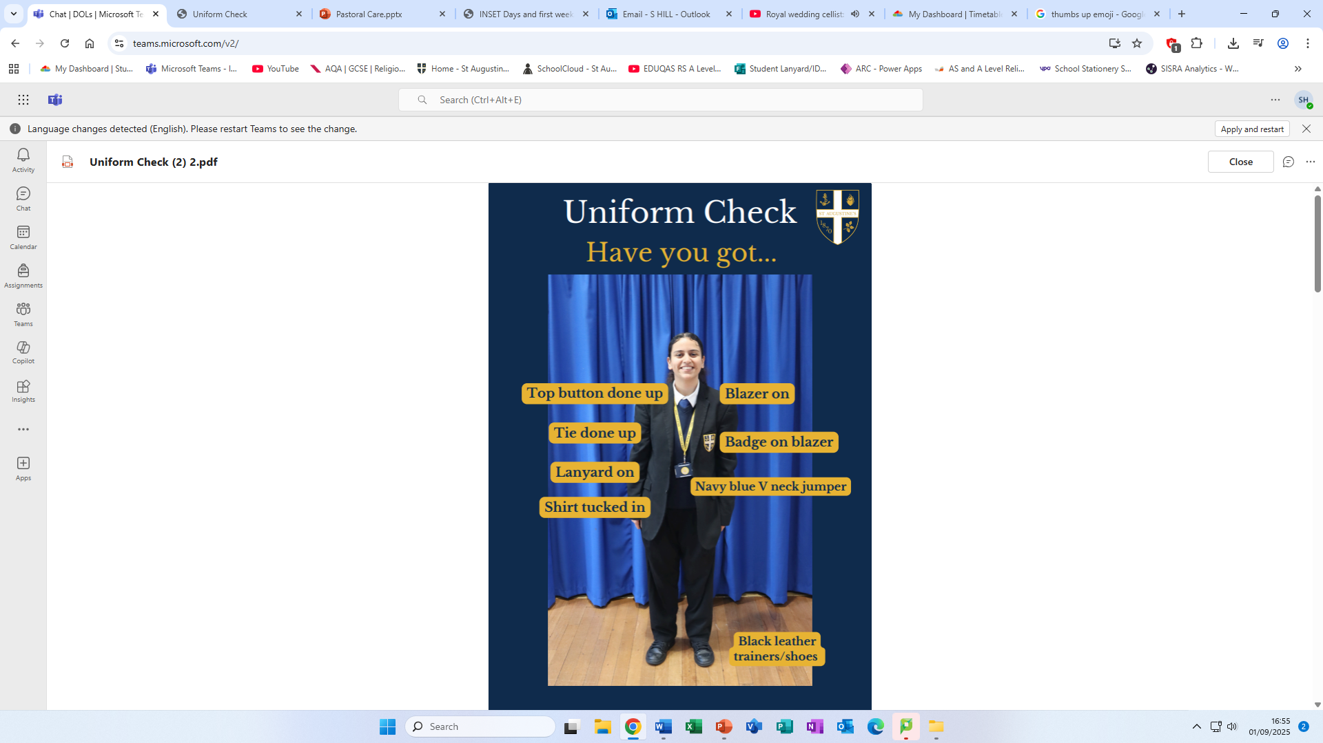
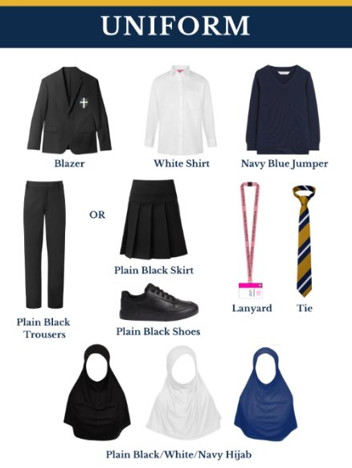
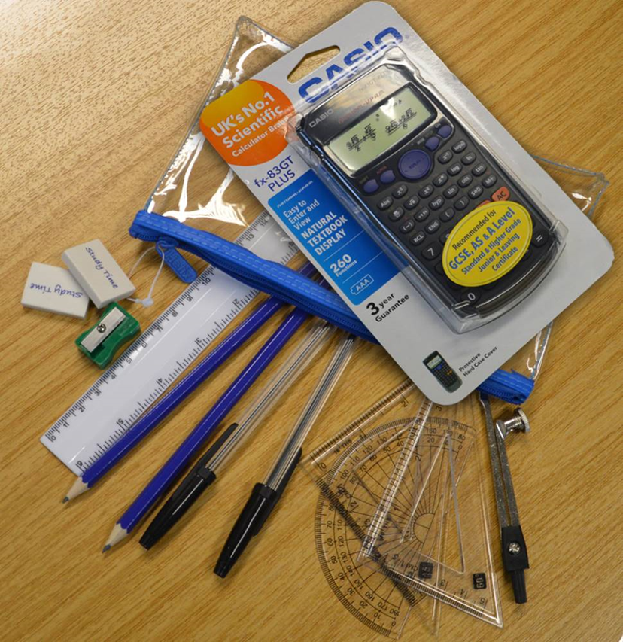
How can our students be successful - Uniform and Equipment expectations

Slide 10
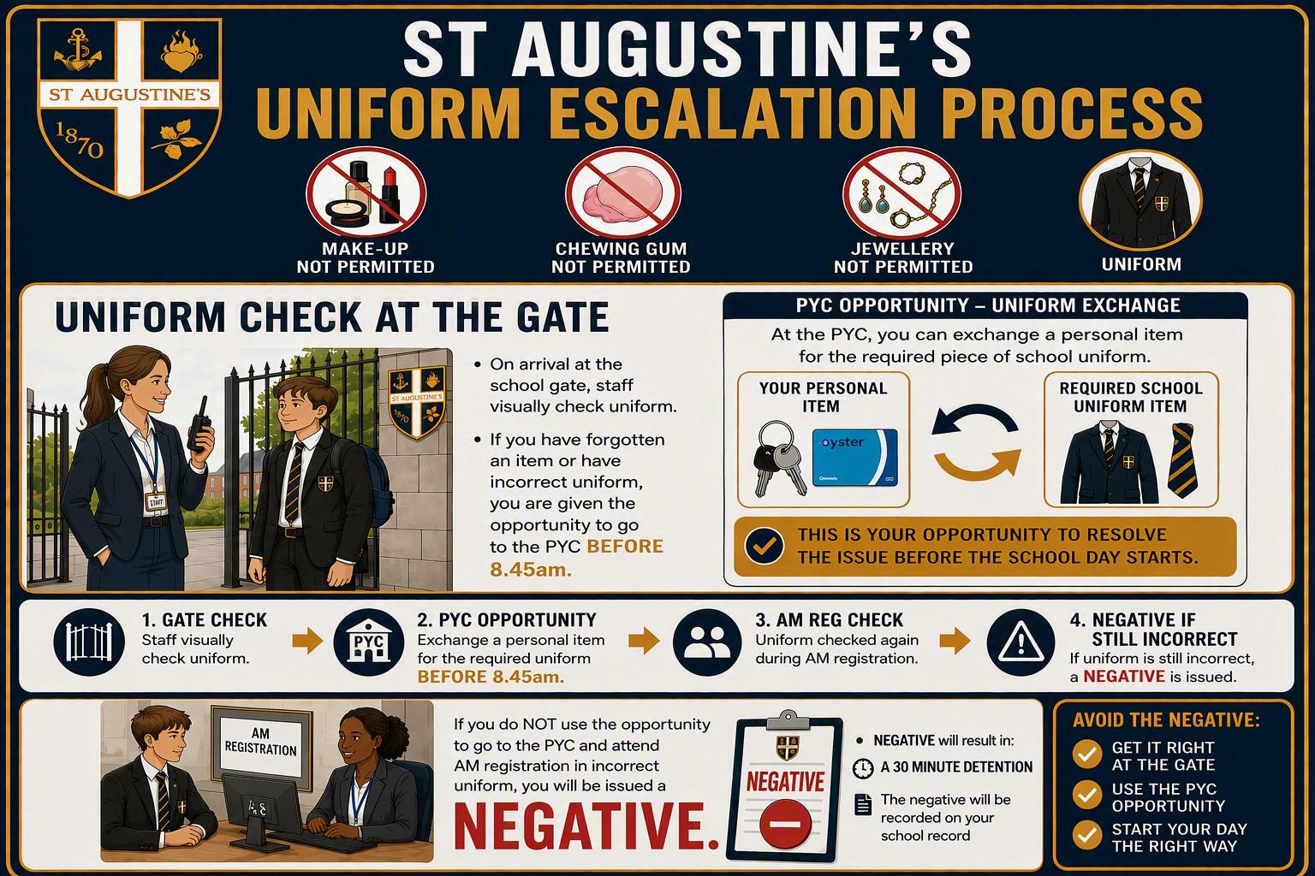

Slide 11
How can you be successful - Ready to Learn, Ready to Succeed:
Every student must:
  Always arrive on time to lessons
  Complete all class work to a high standard
  Complete all homework to a high standard
Notes:
As a form tutor, you're much more than the person who takes the register. You are often the adult who sees your students most consistently every day. That means you're in the best position to notice changes, celebrate successes, and build relationships.
Our aim is that every student leaves form each day feeling known, safe and ready to learn. If we get those three things right, everything else becomes much easier.
You are the adult who sees students every day.
You are often the first person to notice when something isn't right.
Form time sets the tone for the whole school day.
Your role is pastoral, academic and organisational.

Slide 12
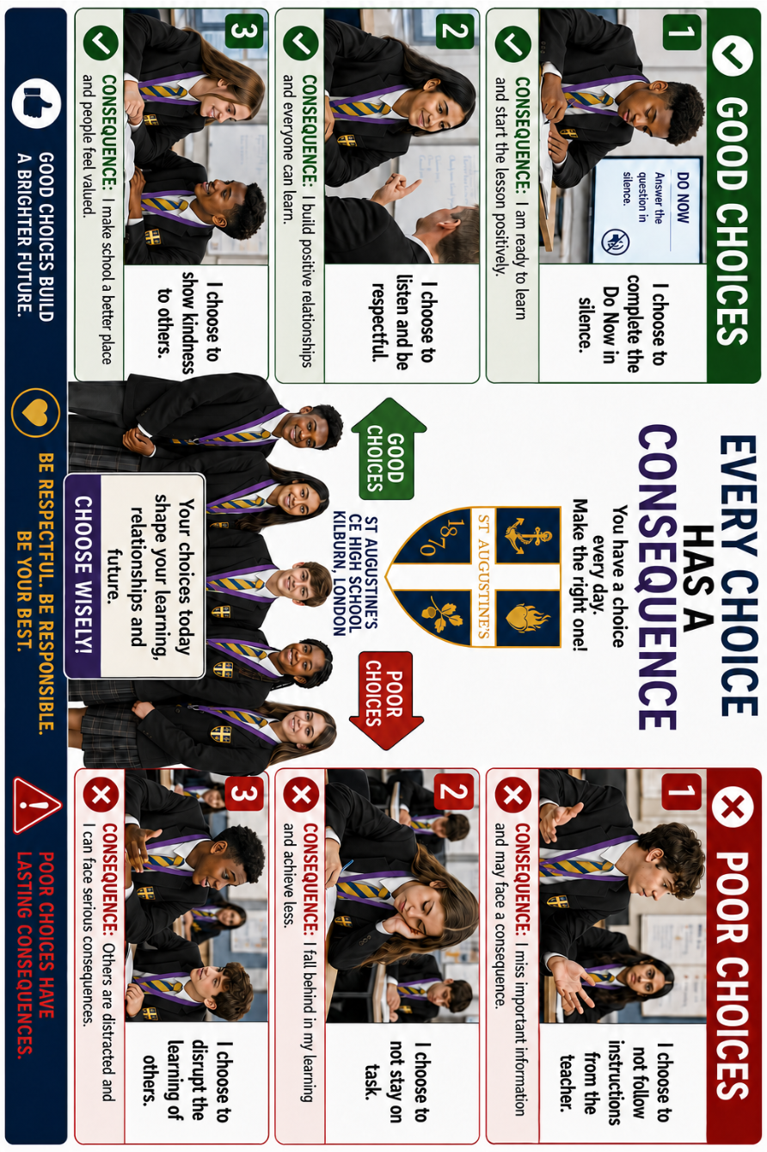

Slide 13
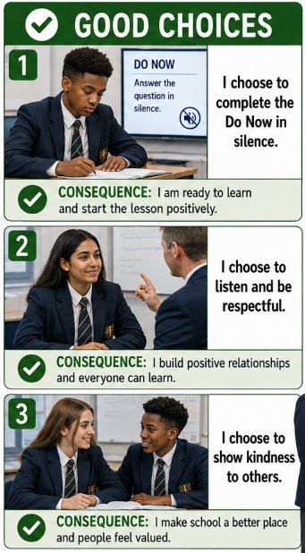
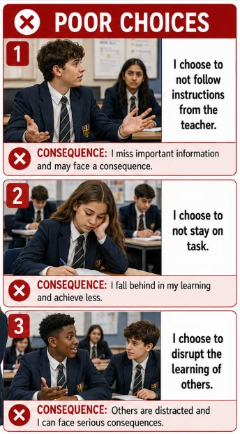
Mother Emily Room
Every teacher at St Augustine’s will make use of the Mother Emily Room in lessons and form time to ensure that lessons are for learning
REMIND
RESET
RELEARN
Notes:
Tutor Time is no different to a lesson
Issue 3Rs with clarity, consistency and conviction

Slide 14
Sanctions at St Augustine's
Mother Emily Room | Restorative Detention | 1 hour Year Team Detention | SLT Detention
This is to ensure lessons are disruption free Students given two warnings on their third they are escorted to the Mother Emily Room In the Mother Emily room they are supervised by a member of our Senior Leadership Team They are given appropriate work to complete Teachers will call parents to explain why they have been referred Teachers will hole a restorative conversation with the students at the end of the day | Students will receive a 30 minute RD for the following: Uniform Issues Lateness to lessons Lateness to School Issues in the playground Students complete work for the duration of this detention | Students will be given a 1 hour detention for the following: Non-attendance at RD Truancy High level behaviour concerns that occur outside of lessons Students will be expected to complete work for the duration of this detention | 1 or 2 hours on a Friday For students who receive 3 or more detention over the course of a week 2 hour SLT is for students who have received 3 or more SLT detentions over a half term Students will be expected to complete work for the duration of this detention
Notes:
Tutor Time is no different to a lesson
Issue 3Rs with clarity, consistency and conviction

Slide 15
Our Pastoral Care​ - Further Support
School councillor
Year Team
Student support services interventions
Future men
Sixth form prefect mentors
Extra curricular clubs
Mentoring
MIND
ARC
Notes:
Tutor Time is no different to a lesson
Issue 3Rs with clarity, consistency and conviction

Slide 16


Slide 17
How can you support your child at home?
Create a Quiet, Distraction-Free Study Space
Set a Consistent Routine
Limit Phone and Screen Time
Encourage effective Revision Strategies:
  Flashcards
  Practice questions
  Past papers
  Teaching the topic to someone else
  Help them identify subjects they find harder and plan extra time for those
Notes:
Tutor Time is no different to a lesson
Issue 3Rs with clarity, consistency and conviction

Slide 18
Where can you buy revision guides?
Consider buying subject-specific guides from these outlets:​
  CGP Books – https://www.cgpbooks.co.uk​
  Amazon – https://www.amazon.co.uk​
  WHSmith – In-store or online​
  Waterstones – https://www.waterstones.com​
  World of Books - https://www.worldofbooks.com/​
Look for guides tailored to your child’s exam board (e.g., AQA, Edexcel, OCR).​
​
Notes:
Tutor Time is no different to a lesson
Issue 3Rs with clarity, consistency and conviction

Slide 19
Intervention – What is it?
Intervention is a timetabled before or after school session ran by departments to support students throughout year 11
It will begin w/c 28/09/2026
Students will receive a bespoke timetable of intervention sessions they MUST attend to support them making the progress expected in that subject
If a students does not attend we will be contacting parents to let them know
A letter with the intervention timetable will be sent out by the end of this week
Notes:
Tutor Time is no different to a lesson
Issue 3Rs with clarity, consistency and conviction

Slide 20
Final tips for parents...
Be positive and encouraging — your support matters!
Help them break down tasks and avoid last-minute cramming
Download and log in to their Teams to check assignments
Offer to test them or make flashcards
Remind them to take breaks and stay hydrated
Recognise their efforts
Purchase revision guides – Revision starts NOW
Notes:
Tutor Time is no different to a lesson
Issue 3Rs with clarity, consistency and conviction

Slide 21
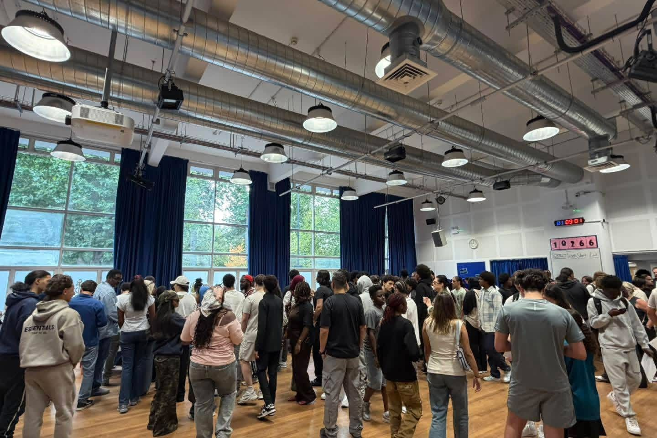

Slide 22
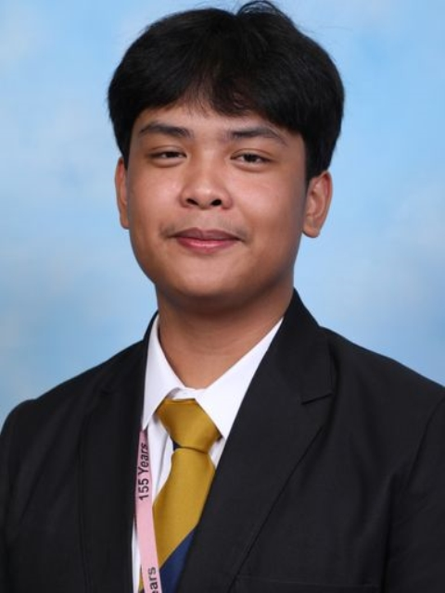
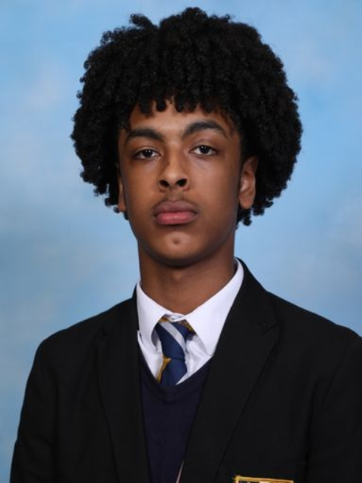
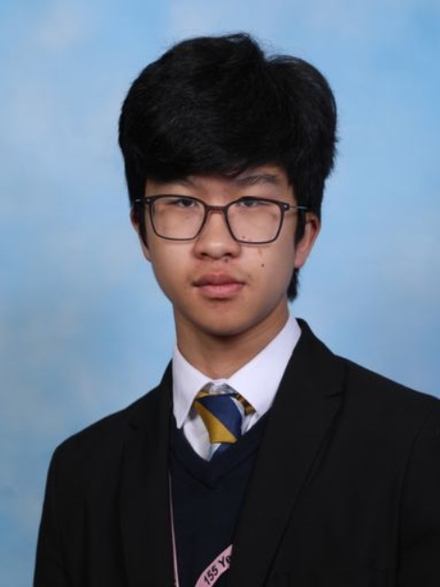
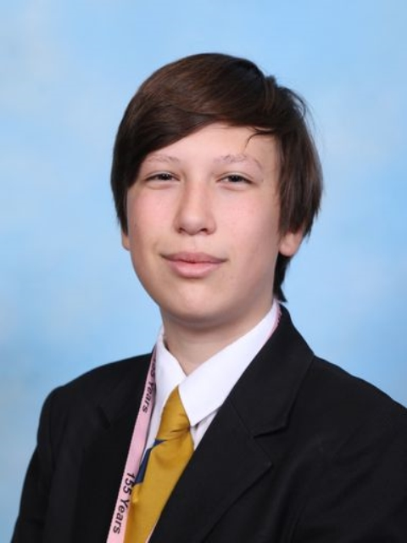
Raffy Pangasate
5 x Grade 9 (Chemistry, English Language, English Literature, History, Physics)
2 x Grade 8 (Biology and Maths)
2 x Grade 7 (RS and Business)
Abdulrahman Kebede
5 x Grade 9 (Biology, Chemistry, English Language, Maths and Physics)
2 x Grade 8 (History and RS)
1 x Grade 7 (English Literature)
1 x Merit for ICT
Nathan Mohammad
2 x Grade 9 (English Literature and English Language)
4 x Grade 8 (Computer Science, History, Maths, RS)
3 x Grade 7 (Biology, Chemistry and Physics)
Nicholas Carvalho
6 x Grade 9 (Combined Science, Geography, Maths, Portuguese, RS)
3 x Grade 8 (Computer Science, English Literature, English Language)
1 x Grade 7 (Business)

Slide 23
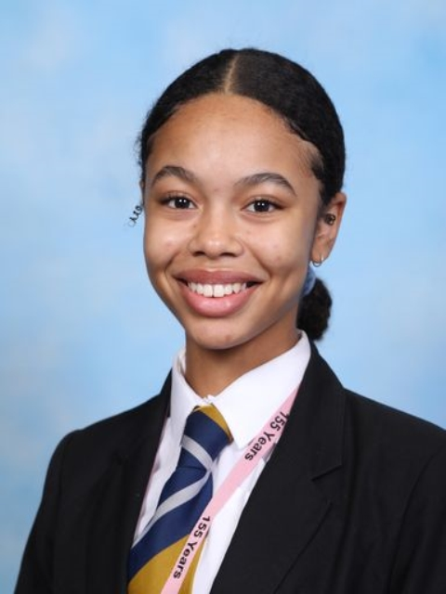
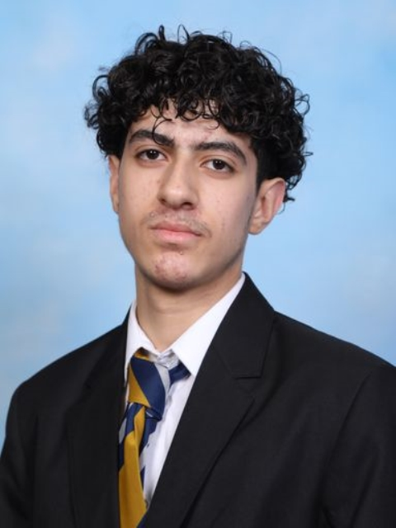
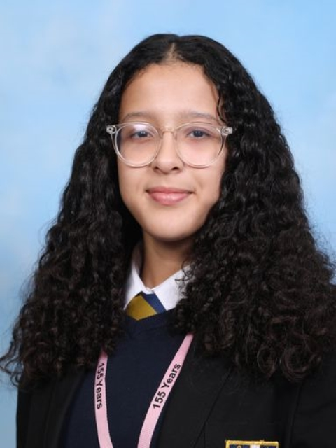
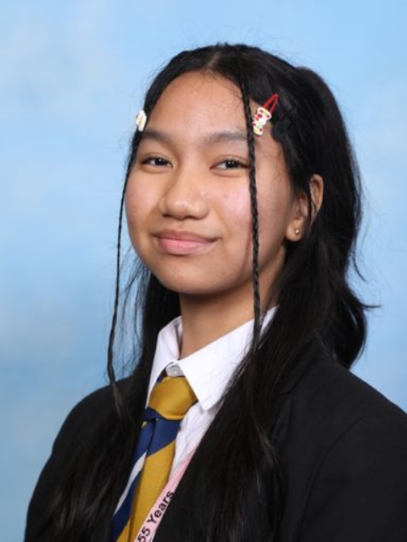
Marlene Augustus
4 x Grade 9 (Biology, Chemistry, Physics, Computer Science)
1 x Grade 8 (Geography)
2 x Grade 7 (RS and Maths)
1 x Grade 6 (English Language)
1 x Grade 5 (English Literature)
Hussein Hakim
3 x Grade 9 (Biology, Chemistry, and Physics)
1 x Grade 8 (Maths)
3 x Grade 7 (English Language, History, RS)
1 x Grade 6 (English Literature)
1 x Grade 5 (Graphics)
Rayhana Moufid
3 x Grade 8 (Biology, Business, Chemistry)
3 x Grade 7 (English Literature, Maths, Physics)
2 x Grade 6 (History, RS)
1 X Grade 5 (English Language)
Alexis Diaz Kayla
2 x Grade 9 (Biology, RS)
4 X Grade 8 (Art, Chemistry, Geography, Physics)
3 x Grade 7 (English Language, English Literature, Maths)

Slide 24
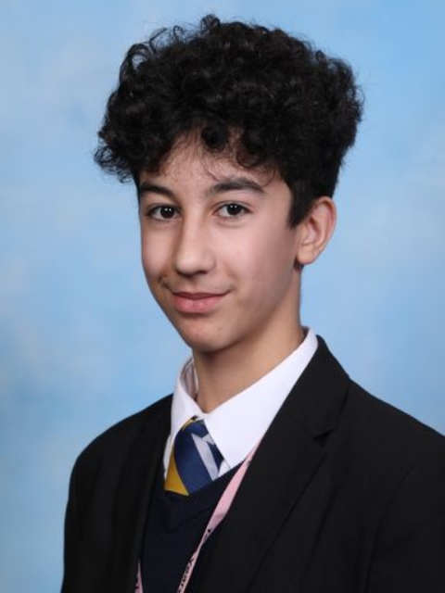
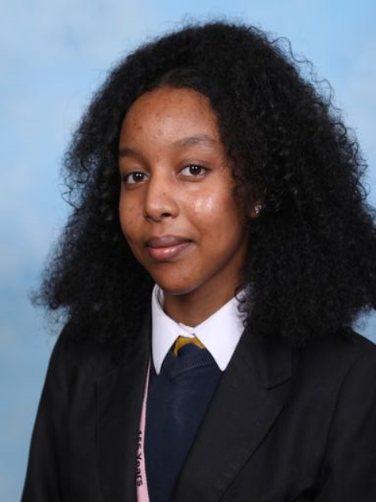
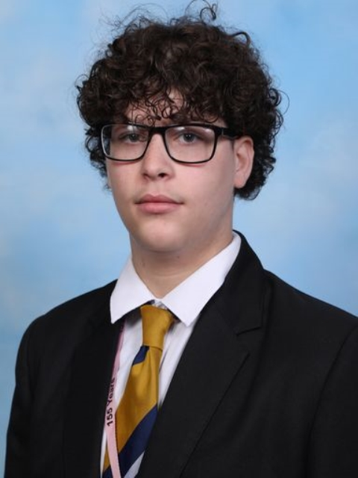
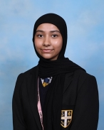
Youssef Fayad
2 x Grade 9 (Chemistry, Physics)
2 x Grade 8 (Biology, Maths)
4 x Grade 7 (Computer Science, English Language, English Literature, History)
1 x Grade 6 (RS)
Soliana Abraham Lukas
5 x Grade 8 (Biology, Chemistry, English Literature, RS and Sociology)
3 x Grade 7 (History, Maths, Physics)
1 x Grade 5 (English Language)
Ahmed Farhoud
4 x Grade 8 (Biology, Chemistry, Maths, Physics)
1 x Grade 7 (History)
4 x Grade 6 (Business, English Literature, English Language, RS)
Naeima Islam
2 x Grade 9 (English Literature and English Language)
2 x Grade 8 (RS and Sociology)
2 x Grade 7 (History, Business)
1 x Grade 6 (Maths)
2 x Grade 5 (Combined Science)

Slide 25
132 days

