Slide 1


Welcome​
Mr H Smith – DOL
Ms S Jarrett – PYC
Ms M Bolayon – Assistant Head KS4
Notes:
“I just want to spend a couple of minutes on attendance because this is going to be a really important focus for us this year.
We are part of the DfE RISE Intensive Support Programme, and our attendance strategy for this year has been reviewed and approved by the DfE.
For you as Form Tutors, the really important thing to remember is that every register matters. The information you put into Bromcom is pulled centrally and forms part of the attendance data that we submit to the DfE.
So please make sure you are taking your registers promptly, accurately, and updating them if information changes. If you're unsure about a code, don't guess — check with the Attendance Team.

Slide 2
Year 10 Welcome Evening
Key Dates for Year 10
Expectations – uniform/attendance and punctuality​
RD/Mother Emily Room/ARC ​
How can you support your child​
Questions​
Notes:
“I just want to spend a couple of minutes on attendance because this is going to be a really important focus for us this year.
We are part of the DfE RISE Intensive Support Programme, and our attendance strategy for this year has been reviewed and approved by the DfE.
For you as Form Tutors, the really important thing to remember is that every register matters. The information you put into Bromcom is pulled centrally and forms part of the attendance data that we submit to the DfE.
So please make sure you are taking your registers promptly, accurately, and updating them if information changes. If you're unsure about a code, don't guess — check with the Attendance Team.

Slide 3
Meet the team
Tutor Group | Form Tutor | Email Address
A10 | Mr G Agbugba | GAgbugba@stahigh.org
B10 | Mr A Balogun | abalogun@stahigh.org
C10 | Mr I Braid | IBRAID@stahigh.org
D10 | Ms V Mehmeti | VMEHMETI@stahigh.org
E10 | Ms R Osewele | ROsewele@stahigh.org
F10 | Mr S Savage | SSavage@stahigh.org
Notes:
“I just want to spend a couple of minutes on attendance because this is going to be a really important focus for us this year.
We are part of the DfE RISE Intensive Support Programme, and our attendance strategy for this year has been reviewed and approved by the DfE.
For you as Form Tutors, the really important thing to remember is that every register matters. The information you put into Bromcom is pulled centrally and forms part of the attendance data that we submit to the DfE.
So please make sure you are taking your registers promptly, accurately, and updating them if information changes. If you're unsure about a code, don't guess — check with the Attendance Team.

Slide 4
Key Dates This Year
Important dates Year 10
17/09/2026 - Year 10 Parent Welcome Evening
12/11/2026 – Year 10 Parents Evening
24/02/2027 – Year 10 Parents Evening Number 2
Summer Term- Year 10 End of Year Mocks
w/c 05/07/2027 - Year 10 Work Related Learning Week
Notes:
“I just want to spend a couple of minutes on attendance because this is going to be a really important focus for us this year.
We are part of the DfE RISE Intensive Support Programme, and our attendance strategy for this year has been reviewed and approved by the DfE.
For you as Form Tutors, the really important thing to remember is that every register matters. The information you put into Bromcom is pulled centrally and forms part of the attendance data that we submit to the DfE.
So please make sure you are taking your registers promptly, accurately, and updating them if information changes. If you're unsure about a code, don't guess — check with the Attendance Team.

Slide 5

How can our students be successful
To be successful we need our students to:
Be in school, on time
Be prepared for the school day
Be ready to learn and ready to succeed
Notes:
As a form tutor, you're much more than the person who takes the register. You are often the adult who sees your students most consistently every day. That means you're in the best position to notice changes, celebrate successes, and build relationships.
Our aim is that every student leaves form each day feeling known, safe and ready to learn. If we get those three things right, everything else becomes much easier.
You are the adult who sees students every day.
You are often the first person to notice when something isn't right.
Form time sets the tone for the whole school day.
Your role is pastoral, academic and organisational.

Slide 6

Be in school and on time…
“Among pupils with no missed sessions over KS4, 83.7% achieved grades 9 to 4 in English and maths compared to 35.6% of pupils who were persistently absent.” https://explore-education-statistics.service.gov.uk/find-statistics/the-link-between-absence-and-attainment-at-ks2-and-ks4
Notes:
As a form tutor, you're much more than the person who takes the register. You are often the adult who sees your students most consistently every day. That means you're in the best position to notice changes, celebrate successes, and build relationships.
Our aim is that every student leaves form each day feeling known, safe and ready to learn. If we get those three things right, everything else becomes much easier.
You are the adult who sees students every day.
You are often the first person to notice when something isn't right.
Form time sets the tone for the whole school day.
Your role is pastoral, academic and organisational.

Slide 7
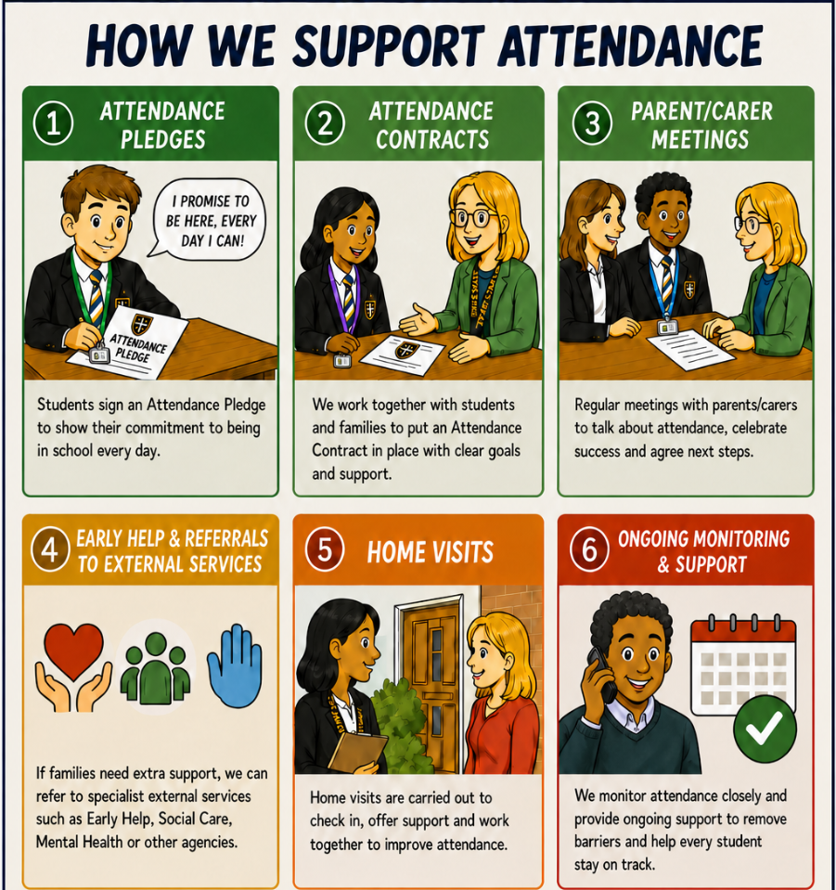
Attendance – How we support students
Notes:
“I just want to spend a couple of minutes on attendance because this is going to be a really important focus for us this year.
We are part of the DfE RISE Intensive Support Programme, and our attendance strategy for this year has been reviewed and approved by the DfE.
For you as Form Tutors, the really important thing to remember is that every register matters. The information you put into Bromcom is pulled centrally and forms part of the attendance data that we submit to the DfE.
So please make sure you are taking your registers promptly, accurately, and updating them if information changes. If you're unsure about a code, don't guess — check with the Attendance Team.

Slide 8
Be in school and on time…
To AM reg:
Students need to be in AM reg at/before 8.45am
Students are late if they arrive at the gate after 8.45am
To lessons:
Students have a 4 minute grace period to get from one lesson to another
If student arrive after this 4 minute period they are marked late
At St Augustine's we believe it is important to maximise learning time and ensure every minute of every lesson is disruption free.
Notes:
“I just want to spend a couple of minutes on attendance because this is going to be a really important focus for us this year.
We are part of the DfE RISE Intensive Support Programme, and our attendance strategy for this year has been reviewed and approved by the DfE.
For you as Form Tutors, the really important thing to remember is that every register matters. The information you put into Bromcom is pulled centrally and forms part of the attendance data that we submit to the DfE.
So please make sure you are taking your registers promptly, accurately, and updating them if information changes. If you're unsure about a code, don't guess — check with the Attendance Team.

Slide 9
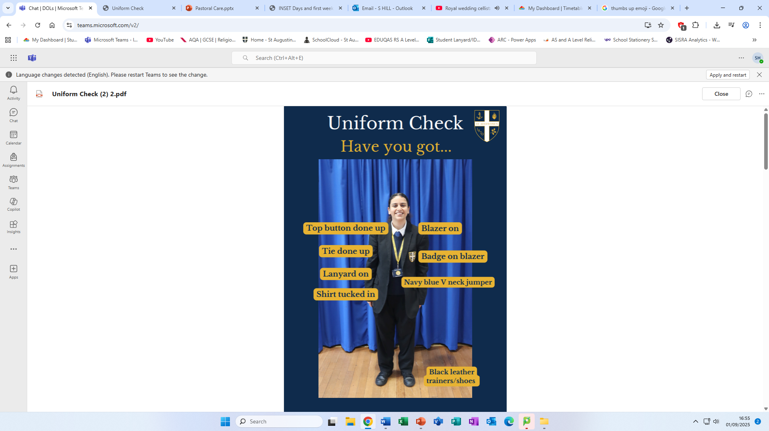
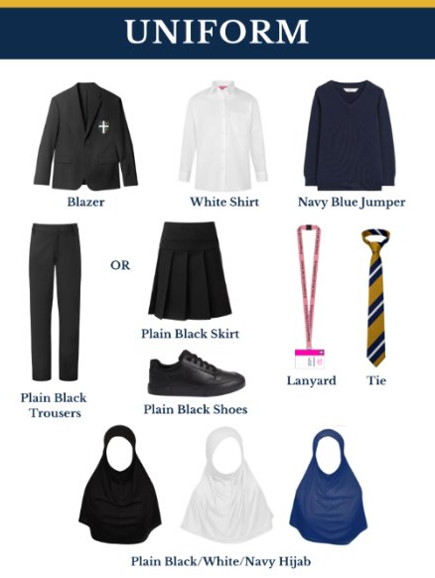
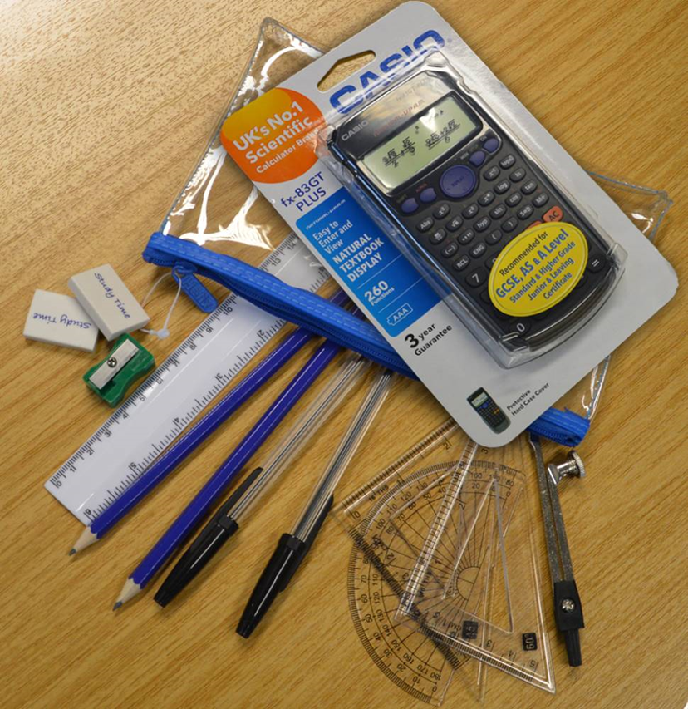
How can our students be successful - Uniform and Equipment expectations

Slide 10


Slide 11
How can you be successful - Ready to Learn, Ready to Succeed:
Every student must:
  Always arrive on time to lessons
  Complete all class work to a high standard
  Complete all homework to a high standard
Notes:
As a form tutor, you're much more than the person who takes the register. You are often the adult who sees your students most consistently every day. That means you're in the best position to notice changes, celebrate successes, and build relationships.
Our aim is that every student leaves form each day feeling known, safe and ready to learn. If we get those three things right, everything else becomes much easier.
You are the adult who sees students every day.
You are often the first person to notice when something isn't right.
Form time sets the tone for the whole school day.
Your role is pastoral, academic and organisational.

Slide 12


Slide 13
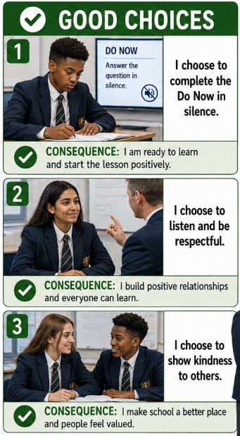
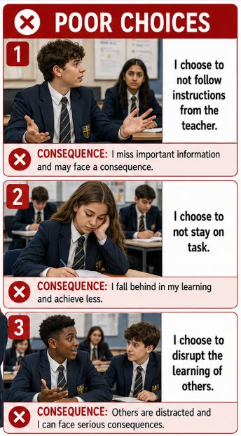
Mother Emily Room
Every teacher will make use of the Mother Emily Room in lessons and form time to ensure that lessons are for learning
REMIND
RESET
RELEARN
Notes:
Tutor Time is no different to a lesson
Issue 3Rs with clarity, consistency and conviction

Slide 14
Sanctions at St Augustine's
Mother Emily Room | 1 hour Year Team Detention | Restorative Detention
This is to ensure lessons are disruption free Students given two warnings on their third they are escorted to the Mother Emily Room In the Mother Emily room they are supervised by a member of SLT They are given appropriate work to complete Teachers will call parents to explain why they have been referred Teachers will hold a restorative conversation with the students at the end of the day | Students will be given a 1 hour detention for the following: Non-attendance at RD Truancy High level behaviour concerns that occur outside of lessons Students will be expected to complete work for the duration of this detention | Students will receive a 30 minute RD for the following: Uniform Issues Lateness to lessons Lateness to School Issues in the playground/corridors Students complete work for the duration of this detention
Notes:
Tutor Time is no different to a lesson
Issue 3Rs with clarity, consistency and conviction

Slide 15


Slide 16
Our Pastoral Care​
St Augustine’s is one of a small number of ‘trauma informed schools’. This contributes significantly to the wellbeing of all, particularly the most vulnerable students. ​
​
-SIAMS 2022​
​
Pupils behave well, and the school is a calm and purposeful environment. Working relationships between staff and pupils are respectful. ​
​
-Ofsted 2023​
Notes:
Tutor Time is no different to a lesson
Issue 3Rs with clarity, consistency and conviction

Slide 17
Our Pastoral Care​ - Further Support
School councillor
Year Team
Student support services interventions
Future men
Extra curricular clubs
Mentoring
MIND
ARC
Notes:
Tutor Time is no different to a lesson
Issue 3Rs with clarity, consistency and conviction

Slide 18
How can you support your child at home?
Create a Quiet, Distraction-Free Study Space
Set a Consistent Routine
Limit Phone and Screen Time
Encourage effective Revision Strategies:
  Flashcards
  Practice questions
  Past papers
  Teaching the topic to someone else
  Help them identify subjects they find harder and plan extra time for those
Notes:
Tutor Time is no different to a lesson
Issue 3Rs with clarity, consistency and conviction

Slide 19
Where can you buy revision guides?
Consider buying subject-specific guides from these outlets:​
  CGP Books – https://www.cgpbooks.co.uk​
  Amazon – https://www.amazon.co.uk​
  WHSmith – In-store or online​
  Waterstones – https://www.waterstones.com​
  World of Books - https://www.worldofbooks.com/​
Look for guides tailored to your child’s exam board (e.g., AQA, Edexcel, OCR).​
​
Notes:
Tutor Time is no different to a lesson
Issue 3Rs with clarity, consistency and conviction

Slide 20
Final tips for parents...
Be positive and encouraging — your support matters!
Help them break down tasks and avoid last-minute cramming
Download and log in to their Teams to check assignments
Offer to test them or make flashcards
Remind them to take breaks and stay hydrated
Recognise their efforts
Notes:
Tutor Time is no different to a lesson
Issue 3Rs with clarity, consistency and conviction

Slide 21
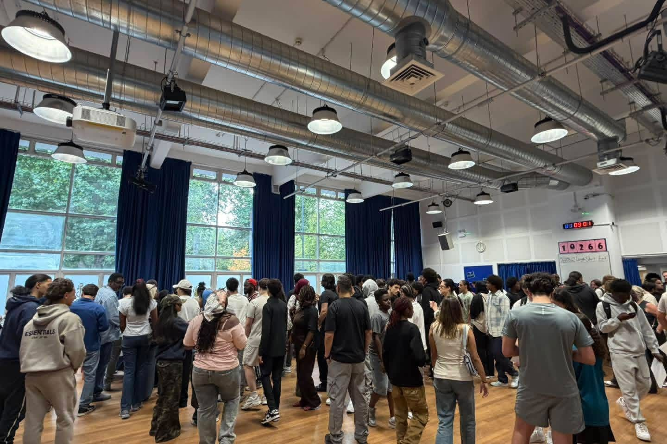

Slide 22
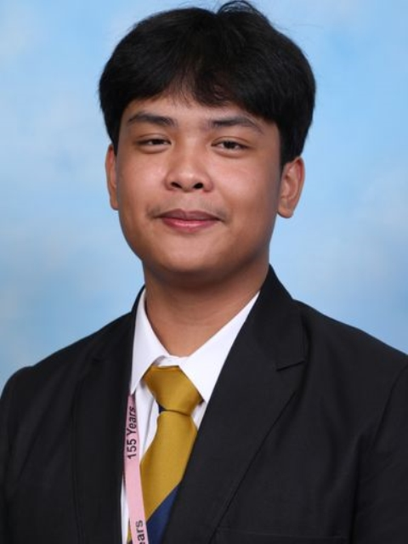
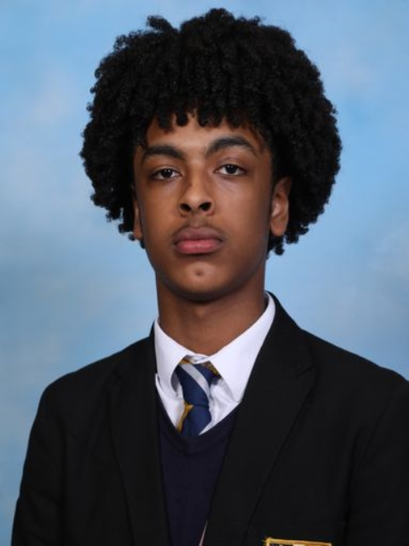
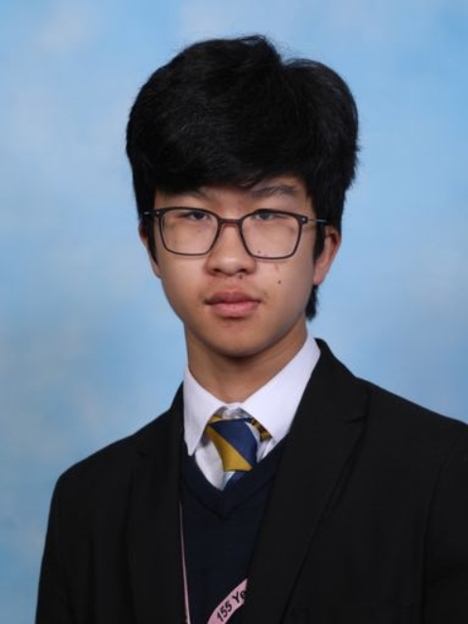
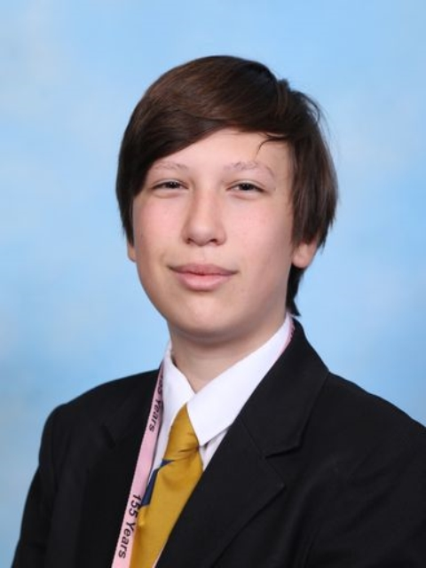
Raffy Pangasate
5 x Grade 9 (Chemistry, English Language, English Literature, History, Physics)
2 x Grade 8 (Biology and Maths)
2 x Grade 7 (RS and Business)
Abdulrahman Kebede
5 x Grade 9 (Biology, Chemistry, English Language, Maths and Physics)
2 x Grade 8 (History and RS)
1 x Grade 7 (English Literature)
1 x Merit for ICT
Nathan Mohammad
2 x Grade 9 (English Literature and English Language)
4 x Grade 8 (Computer Science, History, Maths, RS)
3 x Grade 7 (Biology, Chemistry and Physics)
Nicholas Carvalho
6 x Grade 9 (Combined Science, Geography, Maths, Portuguese, RS)
3 x Grade 8 (Computer Science, English Literature, English Language)
1 x Grade 7 (Business)

Slide 23
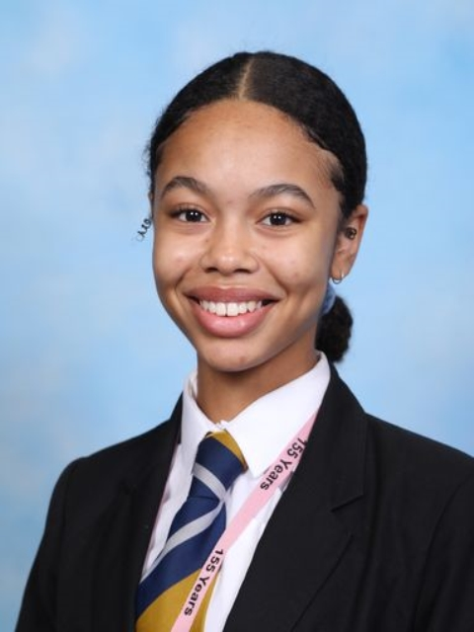
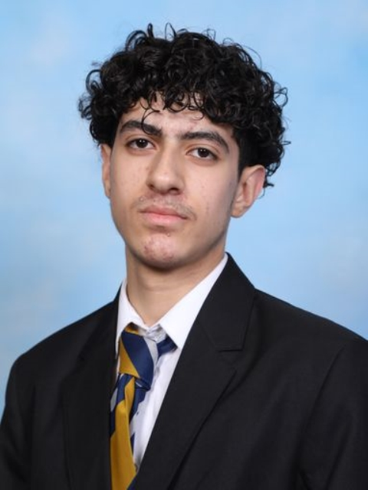
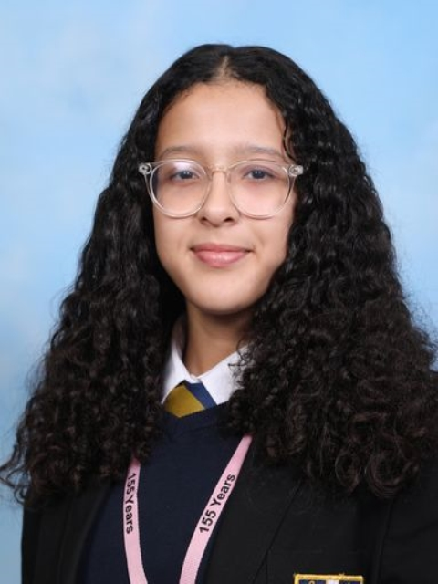
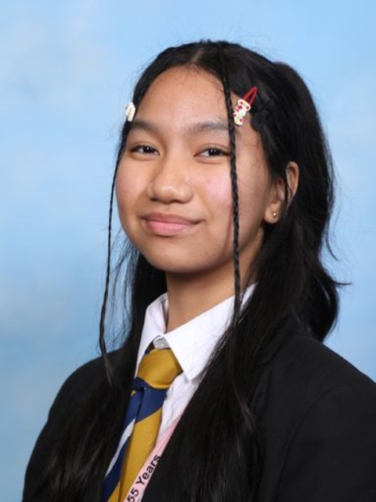
Marlene Augustus
4 x Grade 9 (Biology, Chemistry, Physics, Computer Science)
1 x Grade 8 (Geography)
2 x Grade 7 (RS and Maths)
1 x Grade 6 (English Language)
1 x Grade 5 (English Literature)
Hussein Hakim
3 x Grade 9 (Biology, Chemistry, and Physics)
1 x Grade 8 (Maths)
3 x Grade 7 (English Language, History, RS)
1 x Grade 6 (English Literature)
1 x Grade 5 (Graphics)
Rayhana Moufid
3 x Grade 8 (Biology, Business, Chemistry)
3 x Grade 7 (English Literature, Maths, Physics)
2 x Grade 6 (History, RS)
1 X Grade 5 (English Language)
Alexis Diaz Kayla
2 x Grade 9 (Biology, RS)
4 X Grade 8 (Art, Chemistry, Geography, Physics)
3 x Grade 7 (English Language, English Literature, Maths)

Slide 24
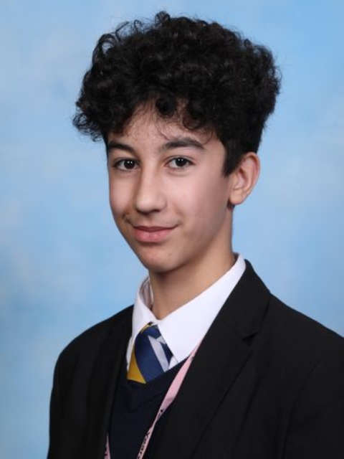
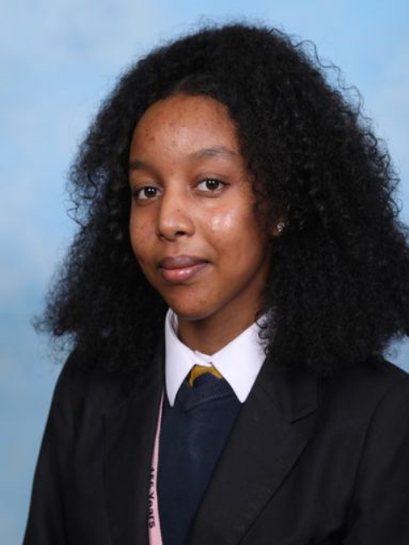
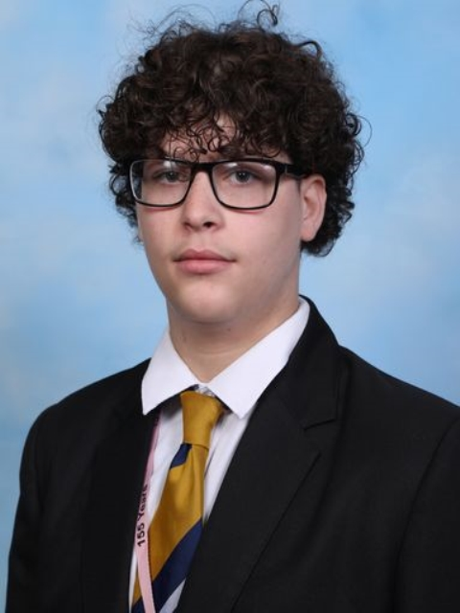
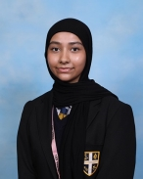
Youssef Fayad
2 x Grade 9 (Chemistry, Physics)
2 x Grade 8 (Biology, Maths)
4 x Grade 7 (Computer Science, English Language, English Literature, History)
1 x Grade 6 (RS)
Soliana Abraham Lukas
5 x Grade 8 (Biology, Chemistry, English Literature, RS and Sociology)
3 x Grade 7 (History, Maths, Physics)
1 x Grade 5 (English Language)
Ahmed Farhoud
4 x Grade 8 (Biology, Chemistry, Maths, Physics)
1 x Grade 7 (History)
4 x Grade 6 (Business, English Literature, English Language, RS)
Naeima Islam
2 x Grade 9 (English Literature and English Language)
2 x Grade 8 (RS and Sociology)
2 x Grade 7 (History, Business)
1 x Grade 6 (Maths)
2 x Grade 5 (Combined Science)

