Slide 1
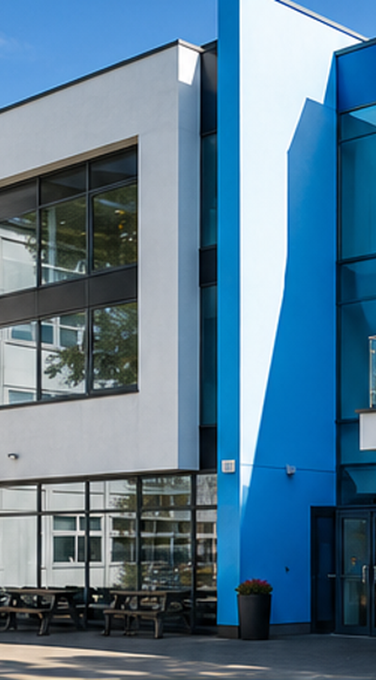

ST AUGUSTINE'S
SIXTH FORM
6TH FORM
PASTORAL EVENING
10th September
Sixth Form Vision:
To support, motivate and inspire all Sixth Form students to become responsible, successful and active global citizens.
Be the Best You Can Be
Faith • Love • Hope • Growth

Slide 2
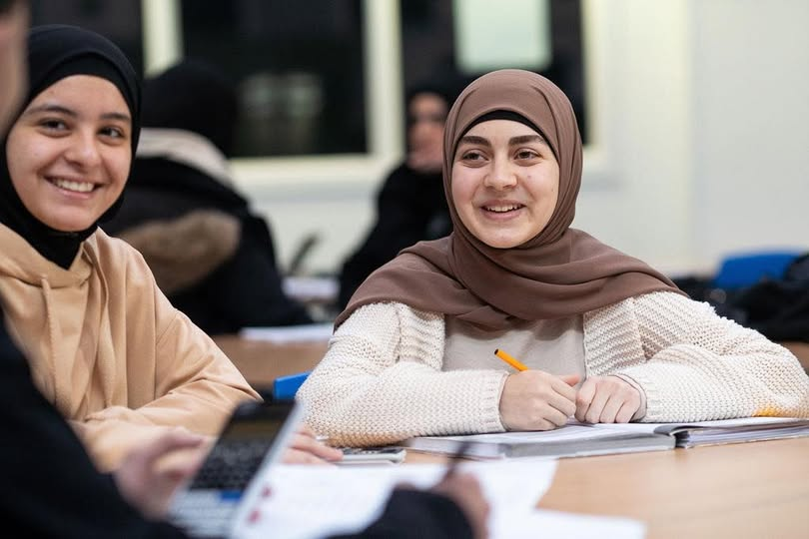
Welcome to St Augustine’s Sixth Form
Pastoral Evening • 10th September
Our vision
To support, motivate and inspire all Sixth Form students to become responsible, successful and active global citizens.
Be the best we can be
Parents as partners
High expectations, support and ambition for every student.
Clear communication and shared routines help students thrive.
Tonight is about building the habits, structures and support that make Sixth Form success possible.
St Augustine's Sixth Form • 6th Form Pastoral Evening
Faith • Love • Hope • Growth

Slide 3
Aims and objectives for the evening
What parents and carers should understand by the end of tonight.
1
Expectations
2
Parent support
3
Rewards & behaviour
Understand our expectations and aspirations for every student.
Know the best ways to support your child during Sixth Form.
Understand the school and Sixth Form systems.
Key dates
Progression
4
5
Know the key moments in the year and what to prepare for.
Understand UCAS, apprenticeships and work-related learning.
Think: What one routine at home would make the biggest difference this term?
St Augustine's Sixth Form • 6th Form Pastoral Evening
Faith • Love • Hope • Growth

Slide 4
This evening at a glance
A clear route through the Sixth Form pastoral story.
Welcome
Team around the child
Expectations
Vision, values and the partnership with parents.
Who supports attendance, wellbeing, mentoring and futures.
Attendance, punctuality, uniform, conduct and study habits.
Careers & futures
Academic support
Questions
Work-related learning, Gatsby benchmarks, UCAS and apprenticeships.
Study periods, independent learning, interventions and exams.
What to do if you need advice, help or support.
St Augustine's Sixth Form • 6th Form Pastoral Evening
Faith • Love • Hope • Growth

Slide 5

Who are the Sixth Form Team?
The staff who support students every day.
Ms Shakes
Mr Amos
Assistant Headteacher in overall charge of Sixth Form
Director of Learning
Ms Donnellan
Mr Scanlan
Pastoral Year Co-Ordinator
Careers / UCAS / Unifrog / Mentoring lead
Mr Ydri
Form Tutors
Work Related Learning Lead
Daily support: attendance, punctuality, uniform and advice
Pastoral Programme
Parents and carers
Mr Goodwin
A key part of the team around each student
St Augustine's Sixth Form • 6th Form Pastoral Evening
Faith • Love • Hope • Growth

Slide 6
Form Tutors and daily pastoral support
Form time is where attendance, communication and guidance come together.
A6F
B6F
C6F
D6F
Mr Leadbetter/ Ms Alawi
Ms Mistry
Ms Benmebarek/ Mr Goodwin
Mr Barrell
E5F
F6F
G6F
Mr Grange
Mr Benyam
Ms Mitsiogianni & Ms De Carvahlo
Pastoral Support
Students should use their Form Tutor as a first point of contact for everyday questions, routines, attendance checks and guidance. Parents should contact the Sixth Form team early if something is affecting school life.
St Augustine's Sixth Form • 6th Form Pastoral Evening
Faith • Love • Hope • Growth

Slide 7
Results
A Level Subject Headlines
Biology – 19% A*-A, 38.1% A*-B
Business – 83.3% A*-B
Chemistry – 21.7% A*-A, 43.5% A*-B
Further Maths – 50% A*, 100% A*-A
History 100% A*-C
Maths – 83.3% A*-C
Physics – 50% A*-A
Politics – 93.3% A*-C
Psychology – 81.8% A*-C
RS – 60% A*-B, 90% A*-C
Sociology – 88.9% A*-C
ST AUGUSTINE'S
SIXTH FORM
To support, motivate and inspire all Sixth Form students to become responsible, successful and active global citizens.
Be the Best
You Can Be
St Augustine's Sixth Form • 6th Form Pastoral Evening
Faith • Love • Hope • Growth

Slide 8
Results
A Level Headlines
Vocational Headlines
A* Grades - 5%
A*-A Grades - 20.6%
A*-B Grades - 50.6%
A*-C Grades - 75.6%
A*-D Grades - 89.4%
A*-E Grades - 96.3%
BTEC Applied Science:
100% Distinction*-Merit
BTEC Sport:
42.9% Distinction*
100% Distinction*- Merit
CTEC Business
15.4% Distinction*
92.3% Distinction*-Distinction
CTEC ICT
40% Distinction*
86.7% Distinction*-Distinction
ST AUGUSTINE'S
SIXTH FORM
To support, motivate and inspire all Sixth Form students to become responsible, successful and active global citizens.
Be the Best
You Can Be
St Augustine's Sixth Form • 6th Form Pastoral Evening
Faith • Love • Hope • Growth

Slide 9
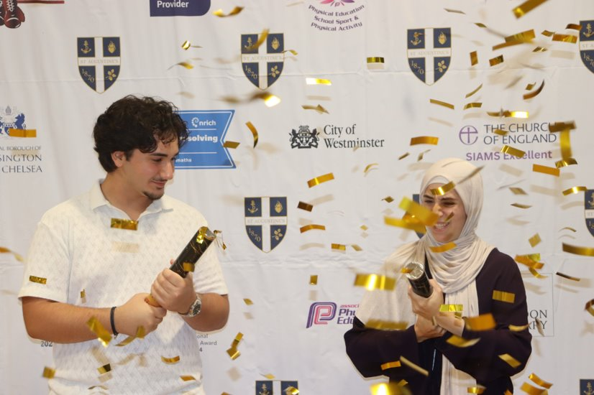
ST AUGUSTINE'S
SIXTH FORM
To support, motivate and inspire all Sixth Form students to become responsible, successful and active global citizens.
Be the Best
You Can Be
St Augustine's Sixth Form • 6th Form Pastoral Evening
Faith • Love • Hope • Growth

Slide 10
Student Next Steps
ST AUGUSTINE'S
SIXTH FORM
Mentoring, UCAS, apprenticeships and Unifrog
Mr Scanlan
Sixth Form Pastoral and Academic Mentor
Helping students plan ambitious, realistic and supported routes beyond Sixth Form.
Be the Best
You Can Be
St Augustine's Sixth Form • 6th Form Pastoral Evening
Faith • Love • Hope • Growth

Slide 11
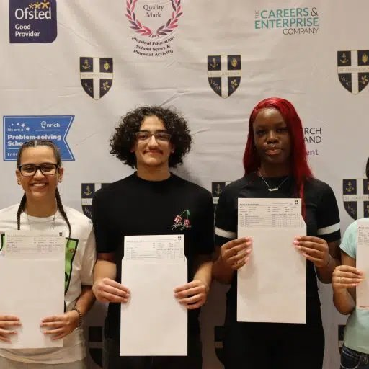
Sixth Form Pastoral and Academic Mentor
Mr Scanlan supports students across mentoring, UCAS, opportunities and enrichment.
Mentoring
UCAS
One-to-one and group support; academic and pastoral.
Guidance on personal statements, applications and choices.
Opportunities
Enrichment
Teams updates and support to access programmes.
Creative, cultural and wider experiences beyond lessons.
The mentoring programme is about supporting students throughout their Sixth Form journey.
St Augustine's Sixth Form • 6th Form Pastoral Evening
Faith • Love • Hope • Growth

Slide 12

UCAS, apprenticeships and Unifrog
Students should start exploring their next steps early.
What is Unifrog?
A further education platform that supports impartial guidance on university courses, apprenticeships, training and careers.
Year 12
Applications
The UCAS process starts now: careers events, personal statement support and early exploration.
Students receive group and individual support to build the strongest application possible.
Opportunities
Start now
Work experience and extracurricular programmes form a key part of personal statements.
All students should be exploring what is available and discussing plans at home.
St Augustine's Sixth Form • 6th Form Pastoral Evening
Faith • Love • Hope • Growth

Slide 13

YEAR 12
Year 13 UCAS Timeline: September to December
Finalising statements and completing applications.
Action Required
By Whom
Due Date
Personal statement 2nd draft returned to students
Form tutors
Monday 21 September
Personal statement final 3rd draft to form tutors
Students
Wednesday 30 September
Personal statement final draft to Mr Scanlan
Early entry students make appointments with Mr Scanlan
Monday 5 October
Once signed off by tutor, appointments available with Mr Scanlan
All students make appointments with Mr Scanlan
From Monday 19 October
Application submitted deadline
Students and Mr Scanlan
Friday 18 December
St Augustine's • Growth • Faith • Love • Hope

Slide 14
Student Expectations
ST AUGUSTINE'S
SIXTH FORM
Our essentials for Sixth Form success
Mr Amos
Director of Learning
Clear routines, high standards and consistent support help students become independent learners.
Be the Best
You Can Be
St Augustine's Sixth Form • 6th Form Pastoral Evening
Faith • Love • Hope • Growth

Slide 15
Our overall essentials
The daily routines that keep students on track.
Attendance
Communication
In school by 8:45am for an 8:50am start.
Parents call school and message Ms Donnellan for illness or unexpected appointments.
Uniform & lanyards
Punctuality
Correct Sixth Form uniform and lanyards worn at all times.
On time to every lesson and activity.
Professional conduct
Study habits
Jackets off in the building; polite and courteous to staff and students.
Homework and classwork completed; independent study taken seriously.
We are incredibly positive in Sixth Form, but students must do their bit too.
St Augustine's Sixth Form • 6th Form Pastoral Evening
Faith • Love • Hope • Growth

Slide 16
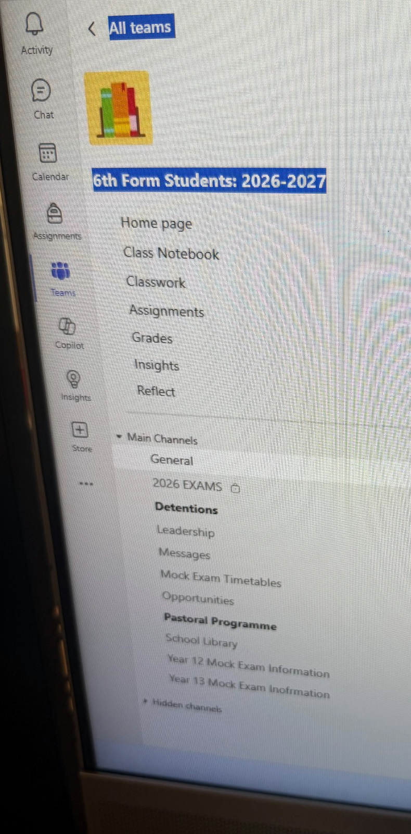
Our overall essentials: Teams + Outlook: check daily
Use the Sixth Form Teams page and your school email so you do not miss key messages, deadlines or opportunities.
.
Daily Communication Routine
Check Teams and Outlook every school day. Read messages, act on deadlines and reply professionally when needed.​
This is your Sixth Form Teams page
Outlook
Teams
Act
Check school email before school and again later.
Use 6th Form Students: 2026–2027 for notices and resources.
Use 6th Form Students: 2026–2027 for notices and resources.
Where to look in Teams
General / Messages • 2026 Exams • Detentions • Leadership • Opportunities • Pastoral Programme • Mock Exam Timetables • School Library
We are incredibly positive in Sixth Form, but students must do their bit too.
St Augustine's Sixth Form • 6th Form Pastoral Evening
Faith • Love • Hope • Growth

Slide 17


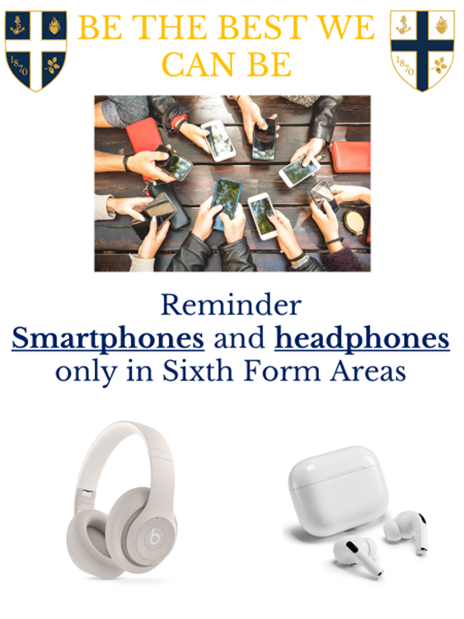
Our Overall Essentials– Sixth key focus this term

Slide 18



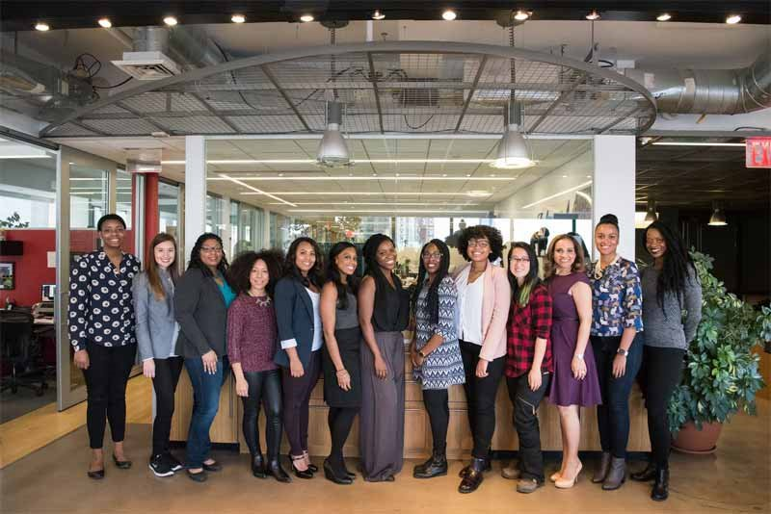




Uniform and High Expectations
Year 12 Expectations Assembly 2026
Faith • Love • Hope • Growth

Slide 19
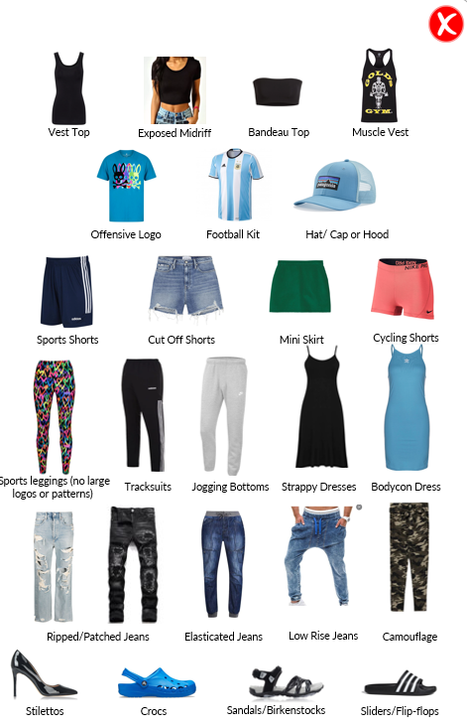

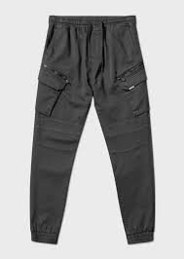


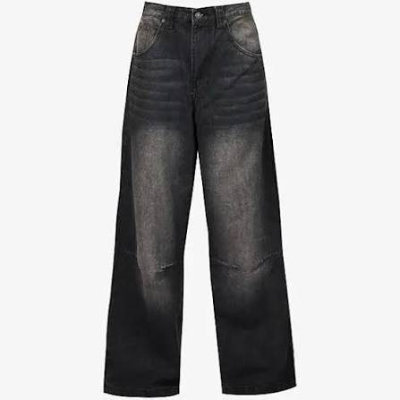

Uniform and High Expectations
Year 12 Expectations Assembly 2026
Faith • Love • Hope • Growth

Slide 20
Attendance matters
Missing lessons quickly adds up across a Sixth Form timetable.
Attendance
Days missed
Lessons missed
Impact
100%
0 days
0 lessons
No gaps — aim to hit and surpass target grades
95%
10 days
57 lessons
Small gaps — catch-up needed
90%
20 days
114 lessons
Persistent absence threshold — strong risk of lower grades
85%
29 days
171 lessons
High risk — syllabus coverage missed
80%
38 days
228 lessons
Severe — hard to complete content
75%
48 days
285 lessons
Very severe — progression at risk
Support from home: check patterns early, avoid avoidable appointments during the school day, and contact us if there are barriers to attendance.
St Augustine's Sixth Form • 6th Form Pastoral Evening
Faith • Love • Hope • Growth

Slide 21
Attendance matters
Missing lessons quickly adds up across a Sixth Form timetable.
% | Days Missed | Weeks Missed | Lessons missed (and study periods) | Impact
100 | 0 days | 0 | 0 | No gaps – Hit and surpass target grades
95 | 10 days | 2 | 57 lessons | Small gaps – top grades /target grades still possible with catch-up
90 | 20 days | 4 | 114 lessons | Persistent absence threshold – strong risk of lower grades
85 | 29 days | 6 | 171 lessons | High risk – syllabus coverage missed, likely grade drop
80 | 38 days | 8 | 228 lessons | Severe – hard to complete content, high chance of underperformance
75 | 48 days | 10 | 285 lessons | Very severe – major loss of learning, multiple grade drops expected
70 | 57 days | 12 | 342 lessons | Critical – unlikely to achieve predicted grades, progression at risk
65 | 67 days | 13 | 399 lessons | Extreme – often leads to failure/resits or alternative pathways
The goal is not simply “more time” — it is purposeful, planned and accountable study.
St Augustine's Sixth Form • 6th Form Pastoral Evening
Faith • Love • Hope • Growth

Slide 22
Attendance matters
Missing lessons quickly adds up across a Sixth Form timetable.
% | Days Missed | Weeks Missed | Lessons missed (and study periods) | Impact
100 | 0 days | 0 | 0 | No gaps – Hit and surpass target grades
95 | 10 days | 2 | 57 lessons | Small gaps – top grades /target grades still possible with catch-up
90 | 20 days | 4 | 114 lessons | Persistent absence threshold – strong risk of lower grades
85 | 29 days | 6 | 171 lessons | High risk – syllabus coverage missed, likely grade drop
80 | 38 days | 8 | 228 lessons | Severe – hard to complete content, high chance of underperformance
75 | 48 days | 10 | 285 lessons | Very severe – major loss of learning, multiple grade drops expected
70 | 57 days | 12 | 342 lessons | Critical – unlikely to achieve predicted grades, progression at risk
65 | 67 days | 13 | 399 lessons | Extreme – often leads to failure/resits or alternative pathways
The goal is not simply “more time” — it is purposeful, planned and accountable study.
St Augustine's Sixth Form • 6th Form Pastoral Evening
Faith • Love • Hope • Growth

Slide 23
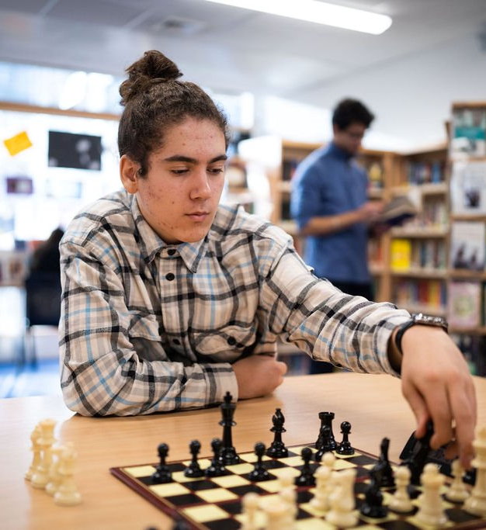
Student expectations: independent study
Sixth Form success depends on how students use their non-timetabled time.
10–12 hours
Students have around 10–12 hours of non-timetabled periods each week.
On-site study
Students remain on the school site and study in dedicated Sixth Form areas.
Teams
Teachers set work and students communicate through their Teams pages.
5 hours
At home, students should complete 5 hours of extra study per subject each week.
The goal is not simply “more time” — it is purposeful, planned and accountable study.
St Augustine's Sixth Form • 6th Form Pastoral Evening
Faith • Love • Hope • Growth

Slide 24



Practice makes permanent
The habits students repeat become the habits they rely on in exams.
Plan
Break large tasks into weekly and daily study actions.
Practice
Use retrieval, exam questions, timed writing and corrections.
Reflect
Use feedback to identify what to do differently next time.
Parents can help by asking: What did you practise today? What did you improve? What will you do next?
St Augustine's Sixth Form • 6th Form Pastoral Evening
Faith • Love • Hope • Growth

Slide 25
How can you support learning outside school?
Helpful questions to ask at home.
Revision
Exam practice
Where can they revise? Where is the quiet space that supports focus?
What are they doing to practise and improve? Are they using timed conditions?
Wider reading
Elevate Education
Are they using libraries, Teams channels, documentaries or podcasts?
Watch for parent emails with advice on studying, revision, exams and wellbeing.
A powerful routine: ask your child to explain what they learnt, what they practised, and what they will do next.
St Augustine's Sixth Form • 6th Form Pastoral Evening
Faith • Love • Hope • Growth

Slide 26
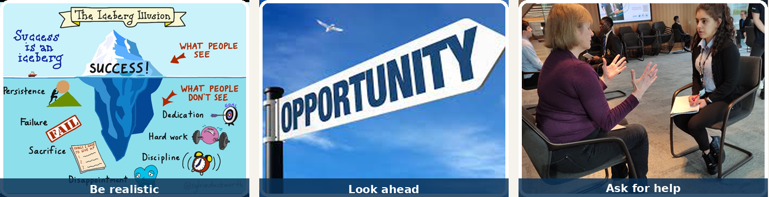
Year 13 Predicted grades and parent support
A realistic and fair process helps students apply wisely.
Predicted grades
How you can help
Students have already been given Predicted grades from Year 12 EOY Mocks for UCAS applications are based on UCAS exams and evidence.
We have a duty to support applications, but also to be realistic and fair to all students.
Talk to your child about careers, courses and apprenticeships.
Read over their statement or ask trusted family/friends to help.
Explore Unifrog together and look at entry requirements.
Support routines around attendance, sleep, quiet study and phone use.
Communicate with school early if you need advice or support.
Realistic choices • informed conversations • stronger applications
Together, we can move mountains.
St Augustine's Sixth Form • 6th Form Pastoral Evening
Faith • Love • Hope • Growth

Slide 27

Preparing for exams
What students and families should have on the radar.
1
2
3
4
Year 13 UCAS exams
Year 13 final mock exams
Year 12 mock exams
Vocational subjects
21st and 28th September
12th and 19th October
Week beginning 1st and 8th February
January Week beginning 4th and 11th
June- Week beginning 7th and 14th June
January exam units
How parents can support
•No appointments / Absences during Mock window
Communication with school
• Create a study environment at home
• Know your child’s revision timetable
• Hold your child accountable for outcomes
• Support timed practice in calm conditions
St Augustine's Sixth Form • 6th Form Pastoral Evening
Faith • Love • Hope • Growth

Slide 28
Preparing for exams
Exam integrity: protecting fairness for every student
What students and families should have on the radar.
Students must not discuss exam content, questions, answers or hints until every student has completed the assessment.
1
2
3
4
Early entry exams
Different teaching blocks
What this means
Year 13 UCAS exams
Year 13 final mock exams
Year 12 mock exams
Vocational subjects
Some students sit papers before everyone else. Sharing what appeared in the exam gives others an unfair advantage and can compromise the process.
In subjects such as Chemistry and Maths, two classes may sit assessments at different times. Students must not pass information between classes.
No exam chat, messages, photos, group-chat comments, “hints”, or discussion of what students wrote until the assessment window is fully complete.
21st and 28th September
12th and 19th October
Week beginning 1st and 8th February
January Week beginning 4th and 11th
June- Week beginning 7th and 14th June
January exam units
Why it matters: exam integrity protects fairness, trust, accurate assessment and preparation for public examinations.
Please reinforce this at home: once an exam has finished, students should move on quietly and avoid conversations about the paper.
St Augustine's Sixth Form • 6th Form Pastoral Evening
Faith • Love • Hope • Growth
St Augustine's Sixth Form • 6th Form Pastoral Evening
Faith • Love • Hope • Growth

Slide 29
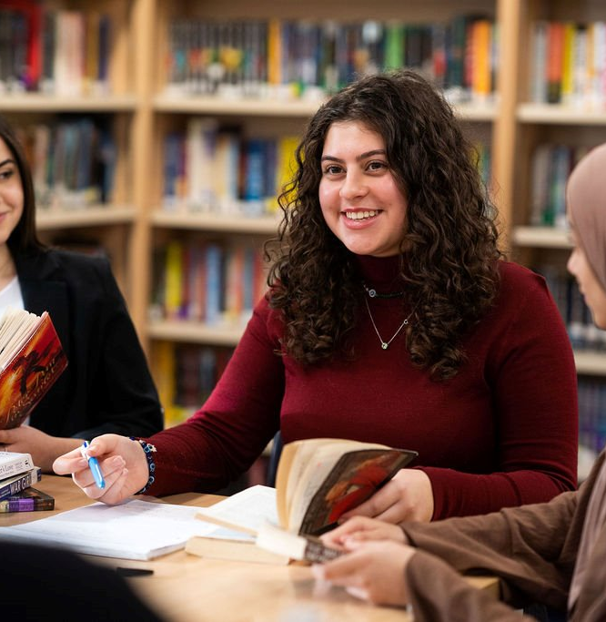
How we are supporting students
Targeted academic and pastoral support across the year.
Afternoon interventions with subjects
Mentoring
One-to-one teacher check-ins informed by data
Subject revision planners
Supervised Direct Study (SDS)
Focused interventions for individual students
Why?
To ensure students are studying, doing the right things and being held accountable for their progress.
St Augustine's Sixth Form • 6th Form Pastoral Evening
Faith • Love • Hope • Growth

Slide 30

Student bursary: financial support
Support with the costs of participating in Sixth Form education.
What is it?
How is it managed?
The 16–19 Bursary Fund provides financial support to help eligible students participate in Sixth Form education.
Funding is provided by the Education and Skills Funding Agency and administered by St Augustine’s Sixth Form.
What can it be used for?
How to apply
Textbooks, stationery and materials needed for the courses students study in Sixth Form.
Only students who are entitled to Free school meals can apply for the school bursary.
New Year 12 students need to complete the link; posted on teams page
Year 13 students already in receipt of bursary do not need to apply.
The information and the application form been posted on students sixth form teams page
Deadline: 30th September
Please see Ms Donnellan with any questions
St Augustine's Sixth Form • 6th Form Pastoral Evening
Faith • Love • Hope • Growth

Slide 31
In summary
What matters most for a successful Sixth Form journey.
High expectations and strong routines
Excellent attendance and punctuality
Purposeful independent study
Regular communication between home and school
Careers, UCAS and apprenticeship planning from early on
A team around every student
Please speak to us if you have any questions or if your child needs support.
St Augustine's Sixth Form • 6th Form Pastoral Evening
Faith • Love • Hope • Growth

Slide 32
Aspirations
ST AUGUSTINE'S
SIXTH FORM
Work Related Learning & Careers Guidance Provision
Mr Ydri
Work Related Learning Lead
Preparing students for future study, apprenticeships, employment and life beyond Sixth Form.
Be the Best
You Can Be
St Augustine's Sixth Form • 6th Form Pastoral Evening
Faith • Love • Hope • Growth

Slide 33
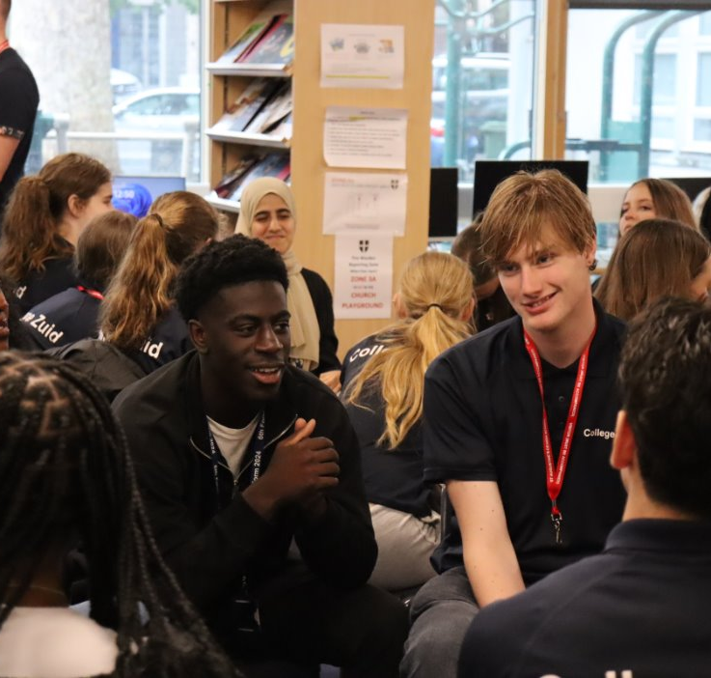
Young people and workplace readiness
Why employability skills and professional habits matter.
of UK employers say young people entering the workforce are generally not “job ready”.*
52%
28%
of employers who hired a young person aged 16–24 felt they were well prepared for the workplace.*
71%
identified behavioural issues, including not knowing how to behave professionally.*
Our response: a comprehensive programme that builds employability, confidence, communication and adaptability.
*According to a study from the CIPD. The Chartered Institute of Personnel and Development (CIPD) / 4 December 2024
St Augustine's Sixth Form • 6th Form Pastoral Evening
Faith • Love • Hope • Growth

Slide 34
The Gatsby Benchmarks
A strong careers programme is built around eight national benchmarks.
A stable careers programme known by students, parents and teachers
Learning from career and labour market information
Addressing the needs of each student
Linking curriculum learning to future careers
1
2
3
4
5
Regular encounters with employers and employees
6
Experiences of real workplaces
7
Encounters with further and higher education
8
Personal guidance from a professional adviser
These benchmarks help us plan meaningful careers education, employer encounters and personalised guidance.
St Augustine's Sixth Form • 6th Form Pastoral Evening
Faith • Love • Hope • Growth

Slide 35
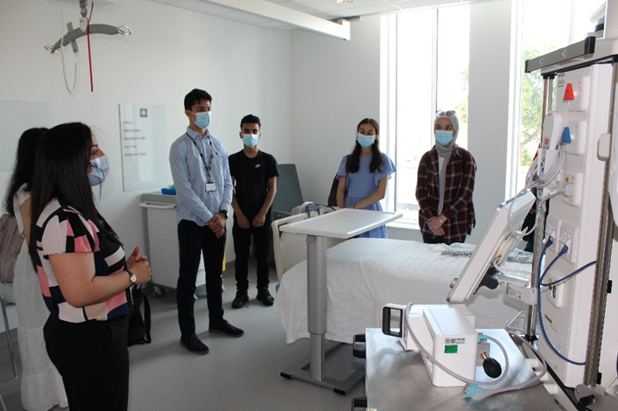
School events and activities
What students can expect across the year.
Employability skills activities in school and offsite
Mentoring programmes and enterprise challenges
One-to-one career meetings with a careers adviser
Careers events and St Augustine’s Careers Fair
Speakers from industries and universities
Work experience and work shadowing days
Mock job interviews and speed interviewing
Subject-based workshops in lessons
Students should take up opportunities early — they strengthen confidence, CVs, applications and personal statements.
St Augustine's Sixth Form • 6th Form Pastoral Evening
Faith • Love • Hope • Growth

Slide 36
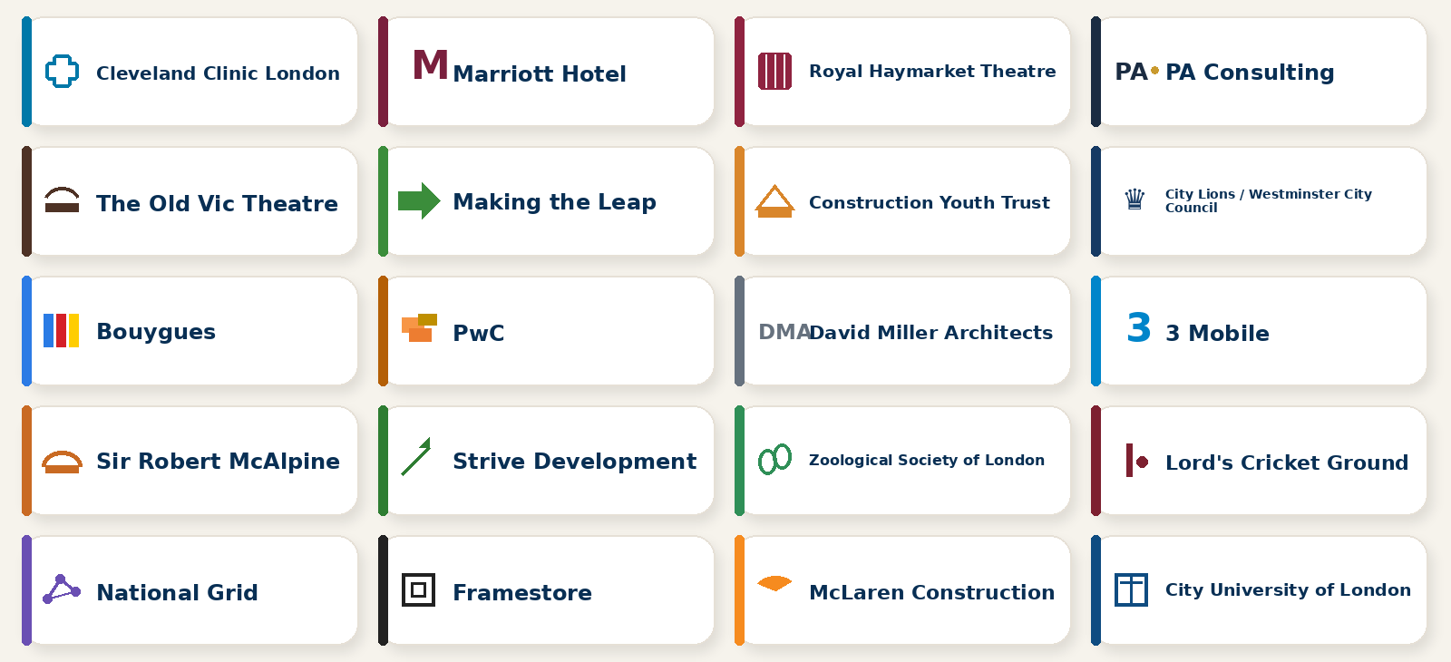
Employer and organisation encounters
Examples of the organisations students may engage with.
Cleveland Clinic London
Marriott Hotel
Royal Haymarket Theatre
PA Consulting
The Old Vic Theatre
Making the Leap
Construction Youth Trust
City Lions / Westminster City Council
Bouygues
PwC
David Miller Architects
3 Mobile
Sir Robert McAlpine
Strive Development
Zoological Society of London
Lord’s Cricket Ground
National Grid
Framestore
McLaren Construction
City University of London
Exposure to different workplaces helps students make informed choices and build professional confidence.
St Augustine's Sixth Form • 6th Form Pastoral Evening
Faith • Love • Hope • Growth

Slide 37
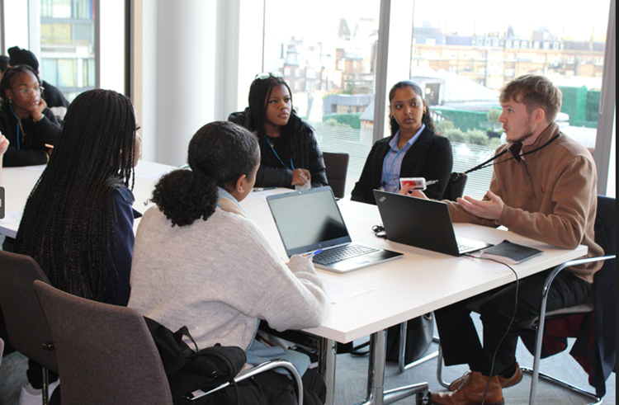
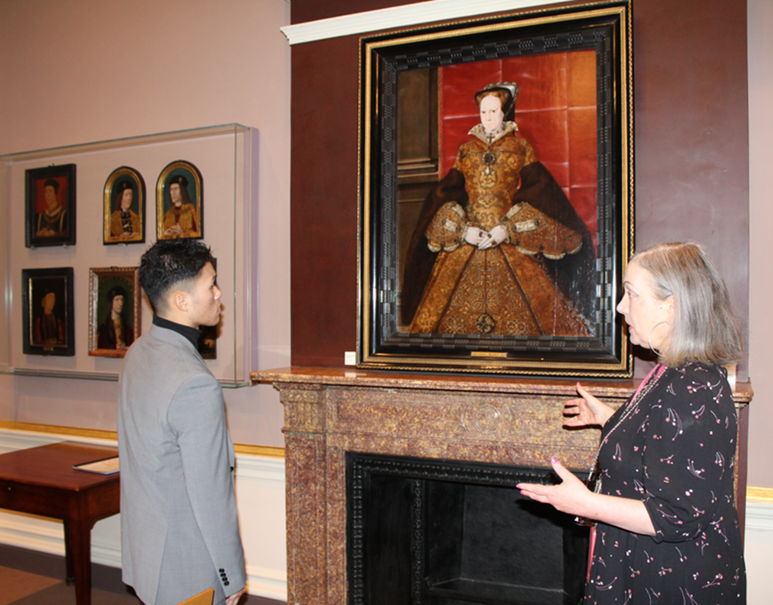
Recommended Career Planning Timeline for Year 12
Autumn Term
Complete a quiz and skills assessment.
Research career interests.
Attend careers fairs and employer events.
Explore university and apprenticeship routes.
Spring Term
Begin building a CV.
Arrange work experience.
Attend university open days.
Create a shortlist of potential pathways.
Summer Term
Write a draft personal statement.
Research student finance and apprenticeships.
Update CV and LinkedIn profile.
Prepare for Year 13 applications.
St Augustine's Sixth Form • 6th Form Pastoral Evening
Faith • Love • Hope • Growth

Slide 38
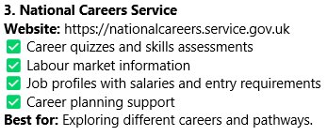
Career Planning Platforms for Year 12 Students & Parents
Unifrog
UCAS
National Carees Service
Amazing Apprenticeships
Find an Apprenticeships
Prospects
Success at School
Springpod
LinkedIn
RateMyApprenticeship
St Augustine's Sixth Form • 6th Form Pastoral Evening
Faith • Love • Hope • Growth

Slide 39
How parents can support careers guidance
Small conversations at home can make a large difference.
01
Encourage self-exploration
06
Encourage networking and mentorship
02
Foster a growth mindset
07
Promote financial literacy
03
Expose them to different careers
08
Support decision-making without pressure
04
Guide education and training choices
09
Promote emotional wellbeing
05
Help set realistic goals
10
Stay involved throughout the journey
Ask open questions:
What are you interested in? What do you want to learn more about? What experience would help you decide?
St Augustine's Sixth Form • 6th Form Pastoral Evening
Faith • Love • Hope • Growth

Slide 40
Thank you for attending
6th Form Pastoral Evening
Please do not hesitate to contact the school if you have any questions.
Be the Best You Can Be
Faith • Love • Hope • Growth

